Slide 1
Nutrition Fact for McDonald’s Menu

Slide 2
Analytical Approach
1. How many calories does the average McDonald's value meal contain?
breakfast, beverages, beef & pork, chicken & fish, coffee & tea salads, snacks & sides, smoothies & shakes, desserts. Plotting in bar chart
2. How much do beverages, like soda or coffee, contribute to the overall caloric intake?
Pie Chart of Category with Beverage, Coffee & Tea, Smoothies & Shakes comparing to whole caloric intake
3. Does ordered grilled chicken instead of crispy increase a sandwich's nutritional value?
Comparing grilled and crispy chicken from the same kind of sandwiches. Plotting in bar chart

Slide 3
Analytical Approach
4. What about ordering egg whites instead of whole eggs?
Normally, an egg white contains fewer calories than a whole egg. It is also lower in protein, cholesterol, fat, vitamins, and minerals. Comparing in bar chart.
5. What is the least number of items could you order from the menu to meet one day's nutritional requirements?
Get the parameter of nutritional requirement (Fat, Protein, Carbohydrate), set the max and min value (parameter value). Total each of nutritional requirement parameter from each item. If total value meet the parameter value, so those combination of items already meet one day’s nutritional requirement

Slide 4
Data Requirement
1. How many calories does the average McDonald's value meal contain?
Category, Calories, Mean of Calories per Category
2. How much do beverages, like soda or coffee, contribute to the overall caloric intake?
Drinks Category(Beverage, Coffee & Tea, Smoothies & Shakes), mean of calories per category, average daily caloric intake(male/female)
3. Does ordered grilled chicken instead of crispy increase a sandwich's nutritional value?
Item==sandwich with grilled or crispy chicken, nutritional value (calories, total fat, carbohydrates, protein)

Slide 5
Data Requirement
4. What about ordering egg whites instead of whole eggs?
Item==contain egg, Nutritional Value(Calories, Total Fat, Carbohydrates, Protein)
5. What is the least number of items could you order from the menu to meet one day's nutritional requirements?
Fat, Protein, Carbohydrate, Category, Item, Total Fat, Total Protein, Total Carbohydrate, parameter value of nutritional requirement

Slide 6
Data Understanding
-Nutritional value refers to contents of food and the impact of constituents on body.
-NUTRITIONAL VALUE: carbohydrates, fats, proteins, minerals, additives, enzymes, vitamins, sugar intake, cholesterol, fat and salt intake.
-Higher in dietary fiber, vitamin D, calcium, iron, and potassium.
-Lower in saturated fat, sodium, and added sugars.
-Saturated and trans fat can raise “bad cholesterol” levels in the blood. High total cholesterol level is a leading risk factor for heart disease.
-Some fatty foods (such as bacon, sausage, and potato chips) often have higher calories with fewer vitamins and minerals than low-fat other foods.

Slide 7
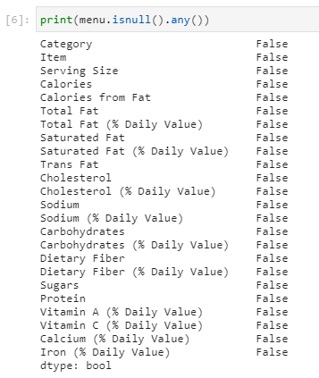
Data Preparation
Check if data contain null value

Slide 8
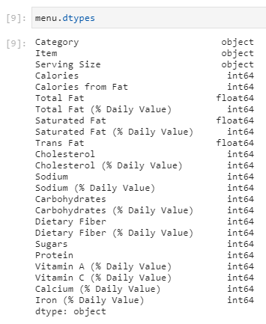
Data Preparation
Check type of each column data

Slide 9
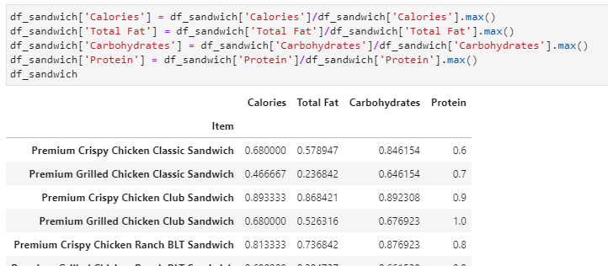
Data Preparation
Normalized the values

Slide 10
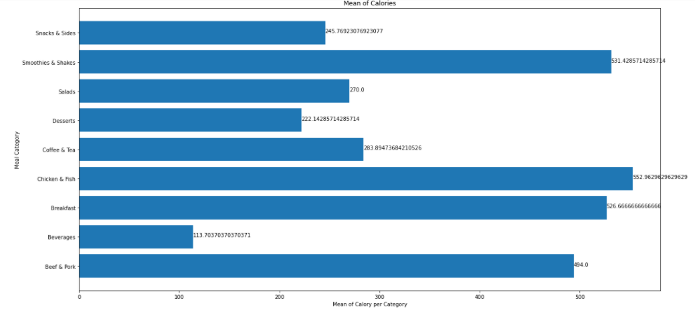
How many calories does the average McDonald's value meal contain?

Slide 11
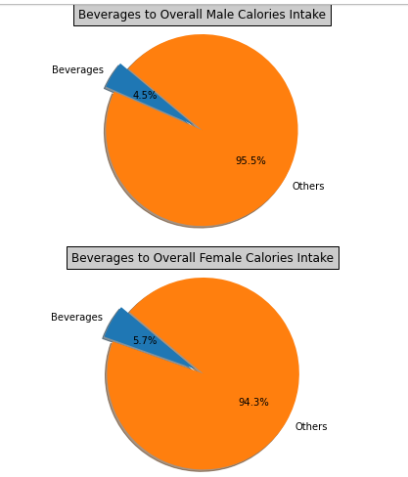
How much do beverages, like soda or coffee, contribute to the overall caloric intake?
Based on National
Health Security UK
Daily Caloric Intake for
Male : 2500
Female : 2000

Slide 12
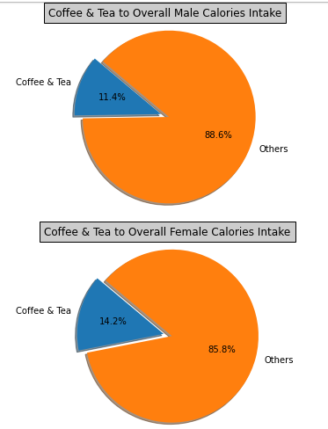
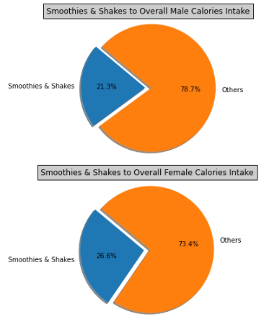
How much do beverages, like soda or coffee, contribute to the overall caloric intake?
Notes:
Kesimpulan: dari semua kategori minuman, yang paling banyak memenuhik kebutuhan kalori harian pada laki-laki dan perempuan adalah smoothies & shakes

Slide 13
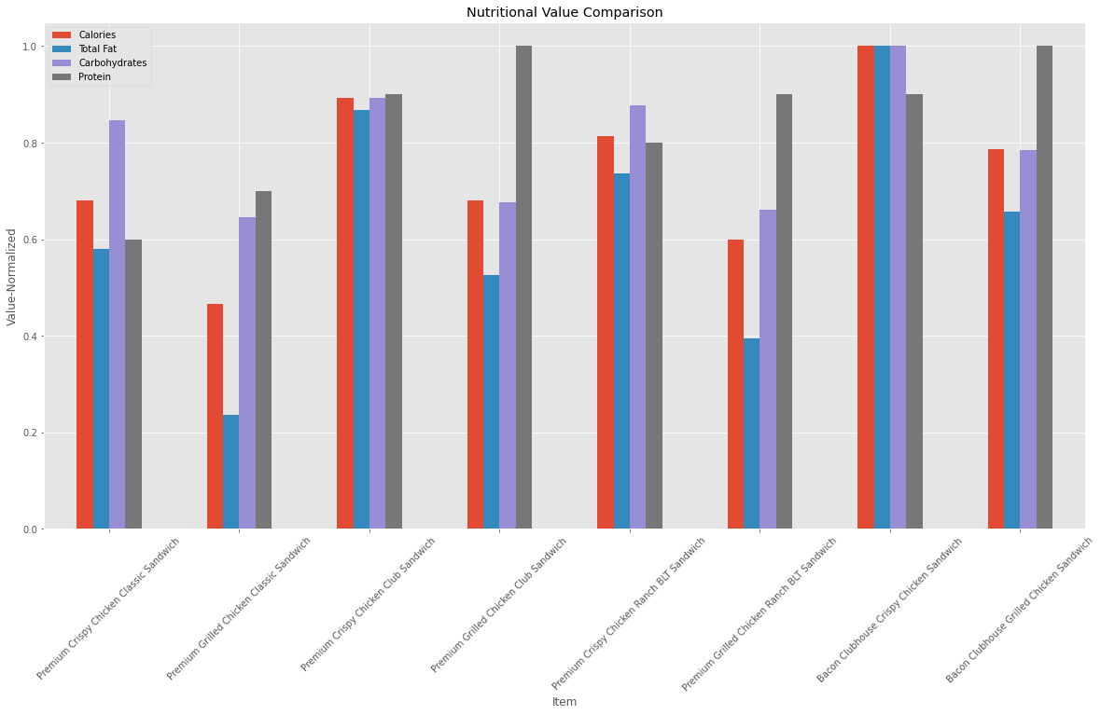
Does ordered grilled chicken instead of crispy increase a sandwich's nutritional value?
Notes:
Kesimpulannya: yeeas

Slide 14
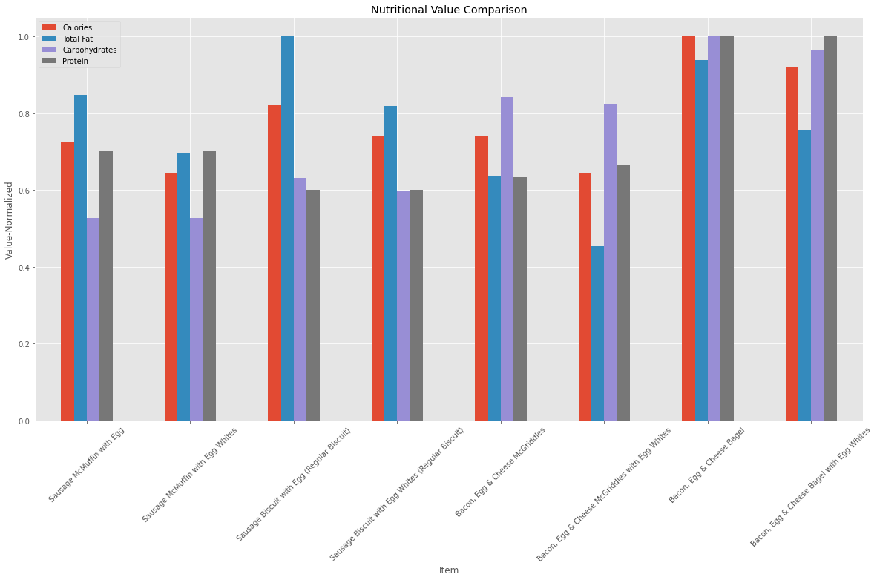
What about ordering egg whites instead of whole eggs?
Notes:
Kesimpulannya: order egg white

Slide 15
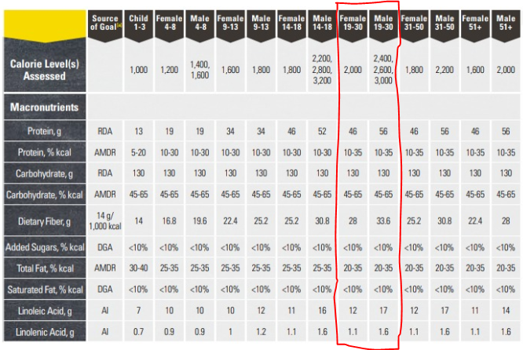
What is the least number of items could you order from the menu to meet one day's nutritional requirements?
Kategori Parameter yang digunakan untuk menghitung kebutuhan nutrisi harian :
Fat: <25% from nutritional requirement
Carbohydrate: 45%-65% from nutritional requirement
Protein: >56 gram

Slide 16
What is the least number of items could you order from the menu to meet one day's nutritional requirements?
Category | Item | Total Carbohydrates = 309 gram
Salads | Premium Southwest Salad with Grilled Chicken
Beverages | Dr Pepper (Large) | Total Protein = 86 gram
Chicken & Fish | Premium Grilled Chicken Ranch BLT Sandwich
Smoothies & Shakes | McFlurry with Oreo Cookies (Medium) | Total Fat = 47 gram
Breakfast | Hotcakes
Total Calories = |  | 2000 cal

Slide 17
Terimakasih

